Slide 1
Time Series Prediction for Wal-Mart Sales
Augusto Perez, James Ghosn, German Baltazar
06/29/2022

Slide 2
Data Description
Weekly information regarding Wal-Mart sales
Dataset with 421,570 observations
Sum of sales per department
Resulting on 6,435 observations
Date | Store | Dept | Weekly_Sales | Temperature
Fuel_Price | MarkDown1 | MarkDown2 | MarkDown3 | MarkDown4
MarkDown5 | CPI | Unemployment | IsHoliday

Slide 3
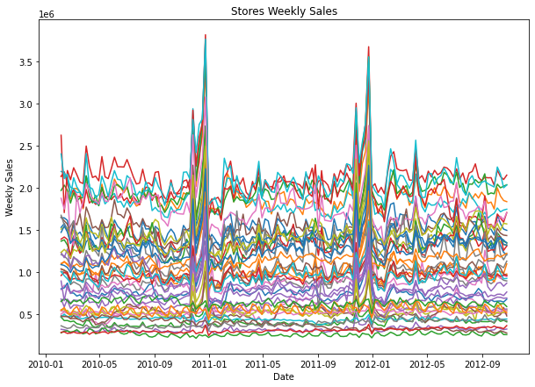
EDA
General observation shows little periodic behavior on the weekly sales
Too many models to predict each store individually
Use of K-Means to cluster the data into smaller groups

Slide 4

Elbow Method
Vary the number of clusters k
Obtain the WCSS (Within-Cluster Sum of Square)
Stay with the model that breaks the drastic change on the WCSS (the elbow)

Slide 5
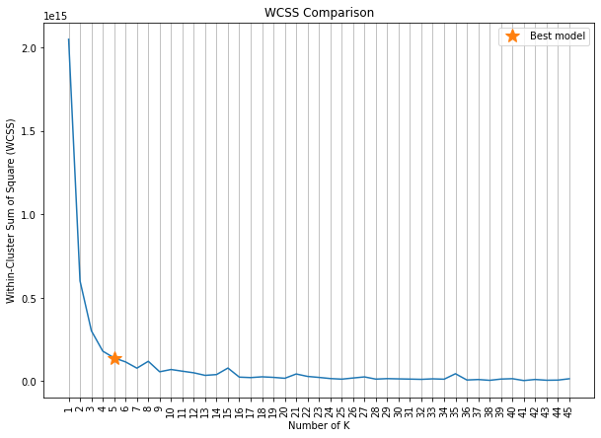
Elbow Method

Slide 6
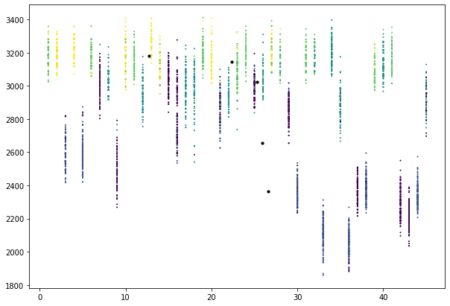
K-Means Visualization
One possible way of observing
Difficult to see multidimensional behavior on 2D

Slide 7
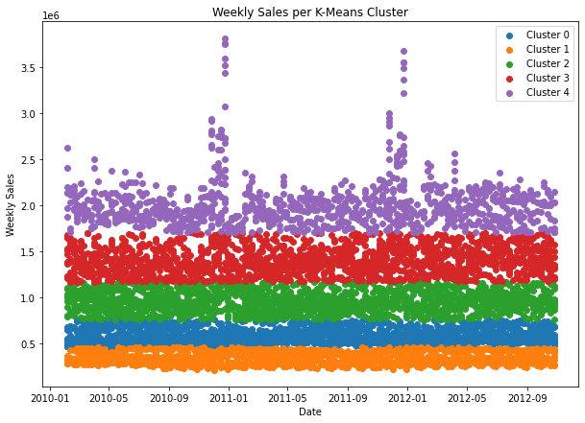
Weekly Sales per Cluster
Classification based on range of prices

Slide 8
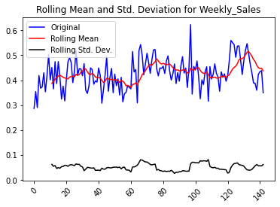
ARIMA
Evaluate for stationarity of clusters
Clusters 1 and 3 were non-stationary
Applied differentiation for stationarity

Slide 9
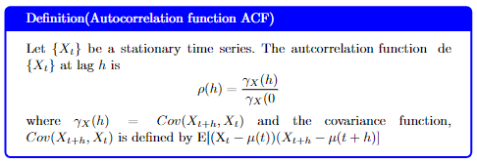
ACF and PCF

Slide 10
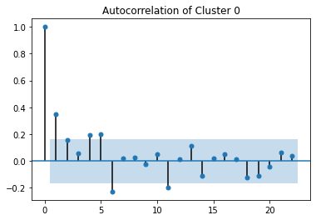
PACF for ARIMA
Selected the smallest lag value closer to the decision boundary (without touching it)
Determines the p parameter for ARIMA model

Slide 11

ACF for ARIMA
Repeat same process for the q parameter

Slide 12
Selected ARIMA Structures
 | p | d | q
Cluster 0 | 0 | 1 | 1
Cluster 1 | 3 | 0 | 4
Cluster 2 | 0 | 1 | 1
Cluster 3 | 1 | 0 | 1
Cluster 4 | 1 | 0 | 5

Slide 13
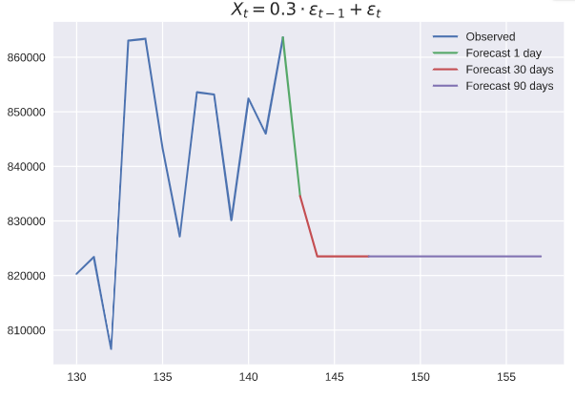
ARIMA Forecast Cluster 0

Slide 14
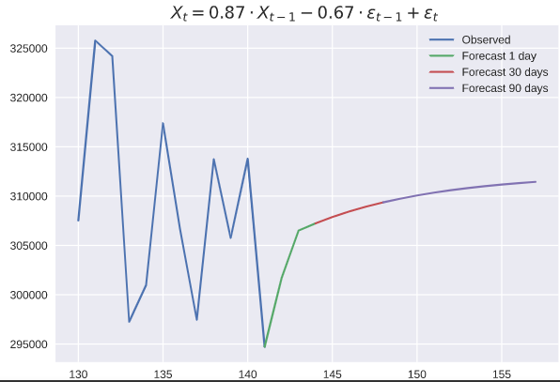
ARIMA Forecast Cluster 1

Slide 15
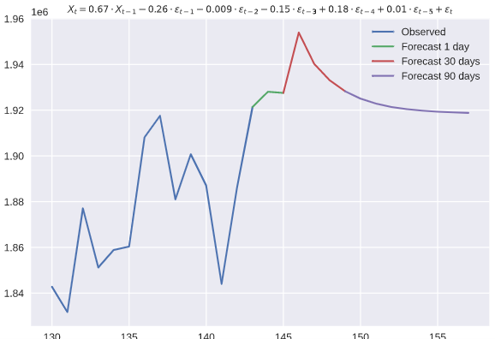
ARIMA Forecast Cluster 2

Slide 16
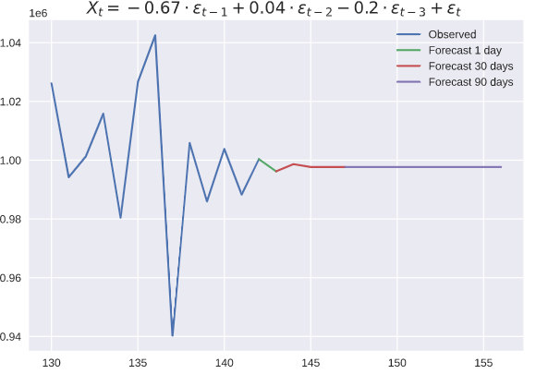
ARIMA Forecast Cluster 3

Slide 17
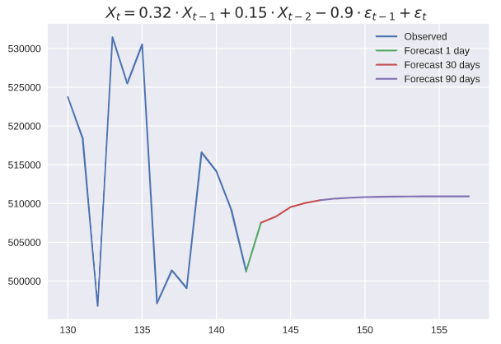
ARIMA Forecast Cluster 4

Slide 18
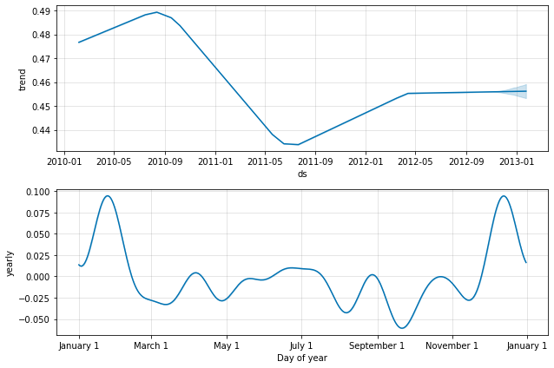
Facebook Prophet

Slide 19
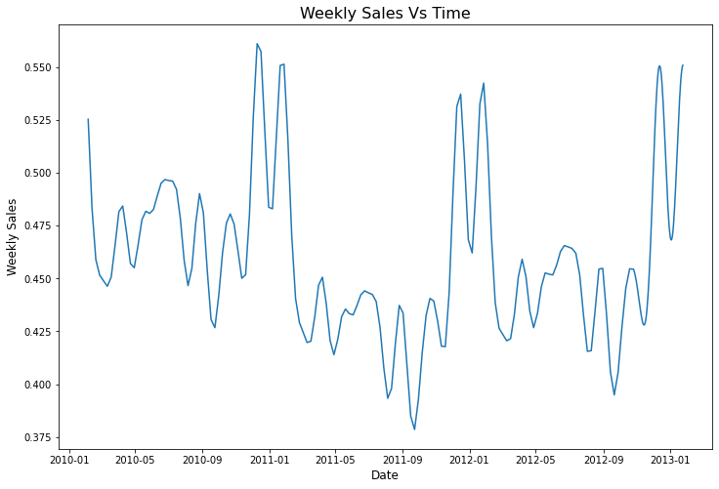
Facebook Prophet

Slide 20
Conclusions
The use of unsupervised methods allows for solving the problem with fewer models
The application of multiple processing techniques like Elbow or normalization makes it easier to generate useful predictions

Slide 21
Thanks!
Any questions?

